Slide 1
Configure and Manage Active Directory

Slide 2
Configure and Manage Active Directory
Configure Active Directory
Managing Active Directory

Slide 3
Active Directory (AD) allows network administrators to create and manage domains, users, and objects (other devices on a network) within a network.
For example, an admin can create a group of users and give them specific access privileges to certain directories on the server.
AD is a directory service developed by Microsoft for Windows domain networks.
It is included in most Windows Server operating systems as a set of processes and services.
It is a primary feature of Windows Server, an operating system that runs both local and Internet-based servers.
Its primary function is to facilitate authentication and authorization of users (members) and resources within an AD domain.

Slide 4
What is authentication?
In simple words, Authentication is the process that addresses the question "Who are you?".
Authentication is done by obtaining a valid username and password on an internet or intranet system.
Once a user is authenticated, the system confirms that you match the identity of whoever you claim to be.
However, authentication doesn't confirm whether you are authorized to access the resource that you might be trying to access; that is done by Authorization.
Ref: https://www.c-sharpcorner.com/UploadFile/84c85b/understanding-windows-authentication-in-detail/

Slide 5
Authorization addresses the question "What Can You Do?"
It happens after successful authentication.
Authorization is the process of verifying that a user is allowed to access a requested resource.
This process determines whether an authenticated user is permitted access to any part of an application, access to specific points of an application, or access only to specified datasets that the application provides.
After all, how can you determine whether someone is allowed to do something if you don't recognize that person's identity.
Ref: https://www.c-sharpcorner.com/UploadFile/84c85b/understanding-windows-authentication-in-detail/

Slide 6
Process and services
What are the differences?
A service is a process that runs in the background and does not interact with the desktop.
With computer software, a service is software that performs automated tasks, responds to hardware events, or listens for data requests from other software.
In a user's operating system, these services are often loaded automatically at startup, and run in the background, without user interaction. It does not interact with the desktop.
https://superuser.com/questions/209654/whats-the-difference-between-an-application-process-and-services
#:~:text=A%20process%20is%20an%20instance,have%20several%20processes%20running%
20simultaneously.&text=A%20service%20is%20a%20process,not%20interact%20with%20the%20desktop.

Slide 7
What's the difference between an Application, a Process, and a Service?
An application is a program that you interact with on the desktop. This is what you spend almost all of your time using on the computer.
Example: Internet Explorer, Microsoft Word, iTunes, and skype.
A process is an instance of a particular executable (.exe program file) running.
A given application may have several processes running simultaneously.
For example, some modern browsers such as google chrome run several processes at once, with each tab actually being a separate instance/process of the same executable.
In some cases, complicated applications may have multiple processes; for example, Visual Studio runs a separate process when it compiles code from when it displays the IDE.
However, most often, a given application is running from a single process; for example, no matter how many Microsoft word windows you have open, only a single instance of winword.exe is running.

Slide 8
A service is a process that runs in the background and does not interact with the desktop. In Windows, services almost always run as an instance of the svchost.exe process, the windows service host process; however there are sometimes exceptions to this.
A touchpad driver, for example, will usually have a process that runs when a user logs in and handles the special features of the touchpad, but isn’t a service and doesn’t show any windows to the user.
Sometimes an application may depend on a certain service.
Printing from any program requires that the print spooler service be active. Installation packages (.msi installers) require that the windows installer service be running.
Antivirus programs usually employ a service so they can continue running even when the user is not logged in.
Many antivirus applications run a process silently in the background which only displays an application to the user when action is required.
Processes usually exit when an application is closed, however, this is not always the case. Some programs, particularly download and backup programs, may continue to run in the background without displaying any windows.

Slide 9
A domain is defined as a logical group of network objects (computers, users, devices) that share the same Active Directory database.
Active Directory has forests and trees which are ways of representing multiple domains.
A tree is a collection of one or more domains and domain trees in a contiguous namespace and is linked in a transitive trust hierarchy.
At the top of the structure is the forest.
A forest is a collection of trees that share a common global catalog, directory schema, logical structure, and directory configuration.
Ref: 4- MCITP 70-640: Active Directory forest and trees (8 minutes)
https://www.youtube.com/watch?v=Whh3kPS0FdA&list=PL1l78n6W8zypXtkh3uWIXbPssc4IGbfb5&index=4

Slide 10
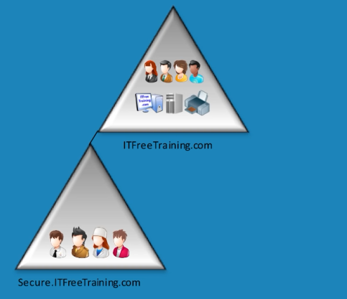






Why have many domains?
For easy separation such as early version of active directory, company structure, politics
Can scale easily.

Slide 11
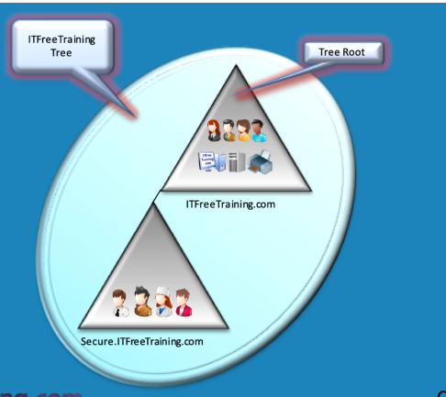

Slide 12
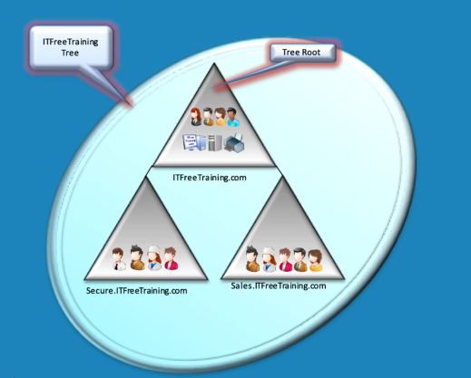


Slide 14
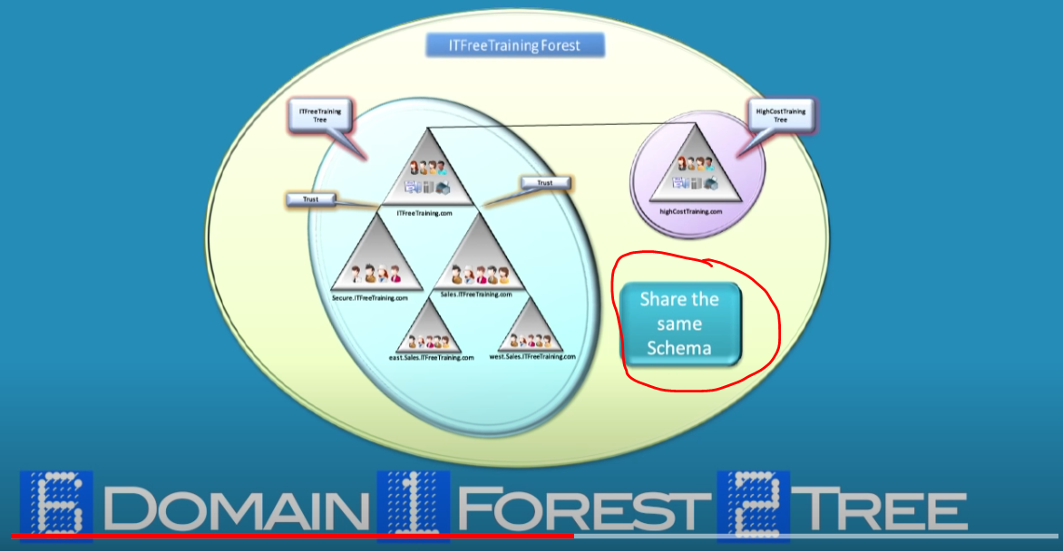

Slide 15
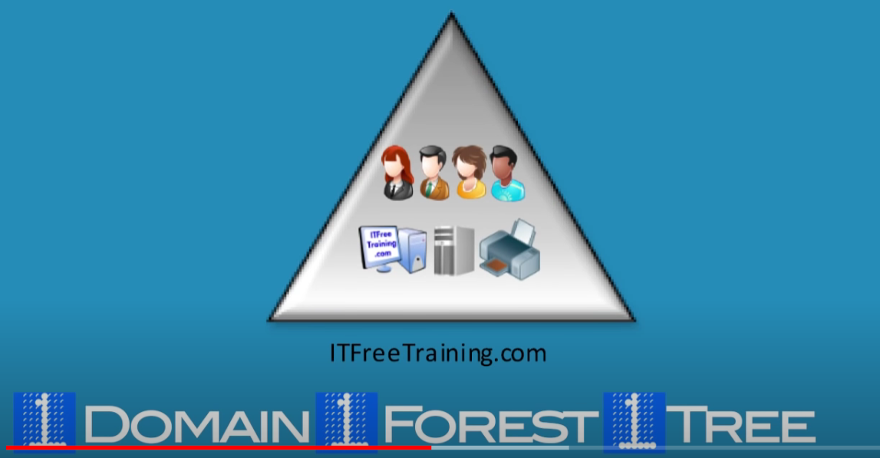
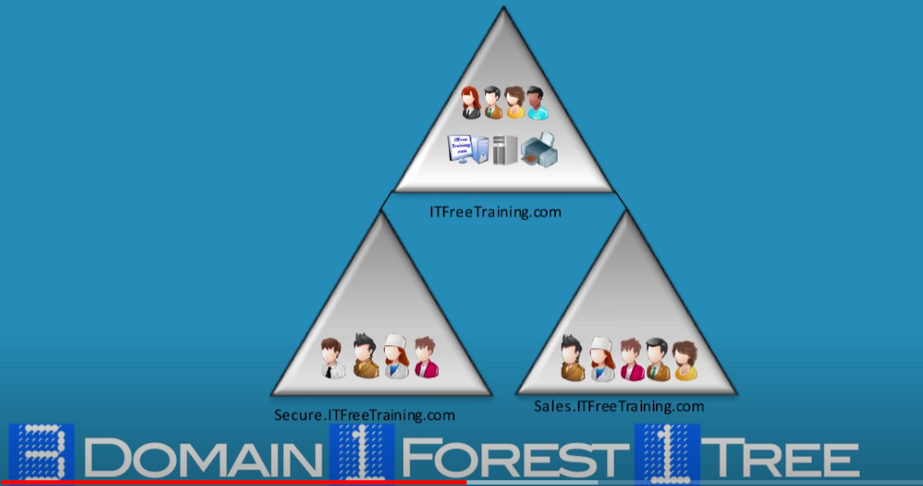
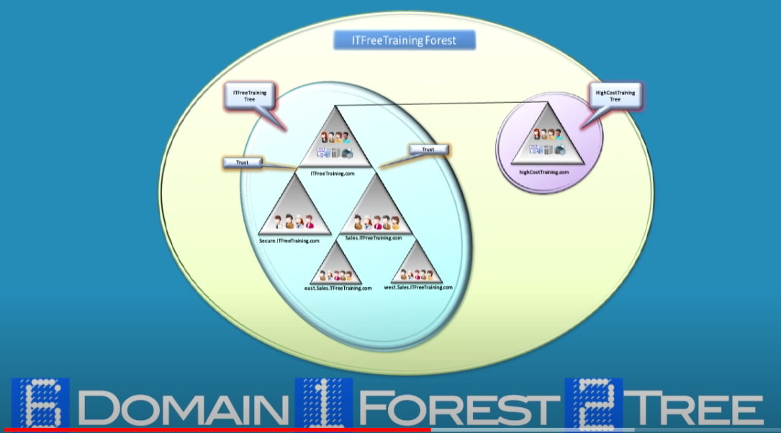
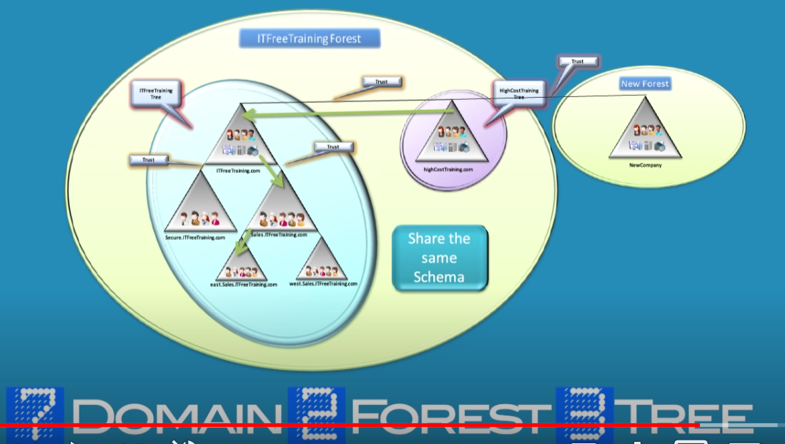
Ref: 4- MCITP 70-640: Active Directory forest and trees (8 minutes)
https://www.youtube.com/watch?v=Whh3kPS0FdA&list=PL1l78n6W8zypXtkh3uWIXbPssc4IGbfb5&index=4

Slide 16
In a forest consisting of more than one domain, do we need to have several ADs?
Do we need to have one AD for each domain?
Can domains in the same forest gain information and access to each other?
Can domains in different forests share resources with each other? If yes, how?
To be an AD, need to be DC?

Slide 17




















Slide 18
Introduction To Active Directory
https://www.youtube.com/watch?v=OTpbQkW3kj4
MCITP 70-640: Active Directory Under The Hood
https://www.youtube.com/watch?v=hoodfyq30NA&list=PL1l78n6W8zypXtkh3uWIXbPssc4IGbfb5&index=3
What is Active Directory?
https://www.youtube.com/watch?v=i9I5poSokow

Slide 19
What is Active Directory?
https://www.youtube.com/watch?v=qkN4bvqWqvo
Active Directory Domain Services For Beginners - Windows Server 2019
https://www.youtube.com/watch?v=7uLhJ236VD8
Windows Server 2019 - Forest & Domain Functional Levels Q&A
https://www.youtube.com/watch?v=EkjHLkXlzdI&list=RDCMUCxf9VicLnyvZhGplp1SMWVA&index=4
What is Active Directory?(2017)
https://www.youtube.com/watch?v=i9I5poSokow

Slide 20
Active Directory’s services
Active Directory provides several different services, which fall under the umbrella of "Active Directory Domain Services," or AD DS.
These services include:
Domain Services – stores centralized data and manages communication between users and domains; includes login authentication and search functionality
Certificate Services – creates, distributes, and manages secure certificates.
Lightweight Directory Services – supports directory-enabled applications using the open (LDAP) protocol.
Directory Federation Services – provides single-sign-on (SSO) to authenticate a user in multiple web applications in a single session.
Rights Management – protects copyrighted information by preventing unauthorized use and distribution of digital content.
Ref:
https://techterms.com/denition/active_directory

Slide 21
Certificate Services
An SSL certificate, or secure certificate, is a file installed on a secure Web server that identifies a website.
This digital certificate establishes the identity and authenticity of the company or merchant so that online shoppers can trust that the website is secure and reliable.
In order to verify that these sites are legitimate (they are who they say they are), the companies and their websites are verified by a third party, such as Verisign or Thawte.
Once the verification company establishes the legitimacy of an organization and the associated website, they will issue an SSL certificate (for the small fee of a few hundred dollars).
This digital certificate is installed on the Web server and will be viewable when a user enters a secure area of the website.
You can tell you are visiting a secure page when the URL starts with "https." To view the certificate, click the lock icon near one of the edges of your browser window.
Secure Sockets Layer (SSL) is a protocol developed by Netscape for providing a secure connection between two or more devices via the Internet. SSL uses a cryptographic system that uses two keys to encrypt data a public key known to everyone and a private or secret key known only to the recipient of the message.
Ref: https://techterms.com/denition/certicate

Slide 22
Because digital certificates verify a company's current status, they do not last forever.
SSL certificates typically expire every one to three years.
If the certificate is not renewed in time, you may see an alert box pop up that says "This website's certificate has expired.“
This error has nothing to do with you or your computer but is displayed because the Web server you connected to has not renewed its SSL certificate.
While this does not necessarily mean the site is fraudulent, it does show that the site is less than professional.
Ref: https://techterms.com/denition/certicate

Slide 23

The End

